Slide 1
<C++ Intermediate II>

Slide 2
Stacks & Queues
Stacks and Queues are data structures in computer science that store information in a certain order. They are usually used in intermediate steps and are present in a lot of algorithms! Like vectors, they are dynamic in size, and can store any amount of elements! However, they also have some drawbacks which we will see later. Thus, they should only be used in specific situations.

Slide 3
What is a Queue?
A Queue can be represented as a line that follows FIFO (First In, First Out). Think of when you are standing in line to order something, it’s first come first served. If you are the 7th person in line, then the 6 people who came before you get to order first before it’s your turn!

Slide 4
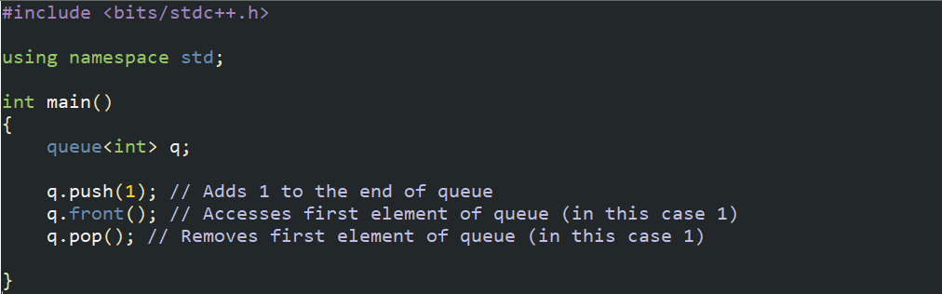
Queue Implementation
We really only have a few operations on a queue<type> which are:
Inserting to the end of queue
Taking element from the front of queue
Removing element from the front of queue

Slide 5
What is a Stack?
A Stack is a bit unconventional, as it follows FILO (First In, Last Out). Imagine stacking boxes on each other. You put the biggest box on the bottom, the next biggest on top of that, and so on and so forth. However, you when you take boxes out, then you would have to take from the top! Thus, you can see that the first box we put in our stack would only be taken out when we take every other box on top off, which means it’s the last box taken out!

Slide 6
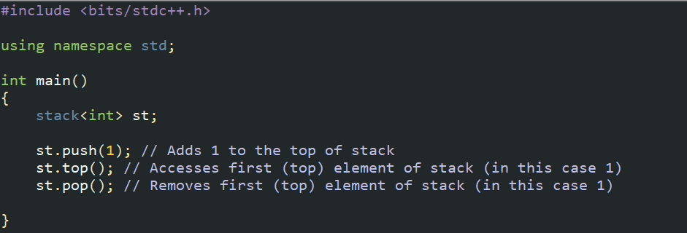
Stack Implementation
We really only have a few operations on a stack<type> as well:
Inserting to the top of stack
Taking element from the top of stack
Removing element from the top of stack

Slide 7
Homework
Since this will be intermediate steps, we will see them more when we work with other algorithms! For now, try these problems:
https://dmoj.ca/problem/ecoo12r3p3
(Don’t use stack, but has stack logic)
https://dmoj.ca/problem/ccc14s3
(You will need to use stacks and/or queues for this one)

